Slide 1
Cucumber (Behaviour Driven Development)
Session4 Anshul Sonpure

Slide 2
Topic of discussion
Cucumber Scenario Outline
What is a Scenario Outline?
Anatomy of a Scenario Outline
Writing Scenario Outlines
Parameterizing Scenario Outlines
Cucumber Background
What is a Background?
Anatomy of a Background
Writing Backgrounds
Sharing State Between Backgrounds and Scenarios

Slide 3
Cucumber Scenario Outline
In Cucumber, a Scenario Outline is a powerful feature that allows us to write a single scenario with multiple sets of test data. It provides a way to create data-driven scenarios, making it easier to test different scenarios with varying inputs.
What is a Scenario Outline?
A Scenario Outline is a template for a scenario that can be executed multiple times with different sets of test data. It helps in reducing the duplication of similar scenarios and makes the feature file more concise and readable.
Anatomy of a Scenario Outline:
A Scenario Outline consists of the following elements:
Scenario Outline keyword: It indicates the start of a scenario outline block.
Scenario name: It provides a descriptive name for the scenario.
Scenario steps: These are the steps that describe the actions and expected outcomes of the scenario.
Examples keyword: It indicates the start of the examples block, which contains the test data sets.
Test data table: It contains the test data sets in tabular format. Each row represents a set of test data, and each column represents a variable or placeholder in the scenario steps.

Slide 4
Writing Scenario Outlines:
To write a Scenario Outline, follow these steps:
Start with the Scenario Outline keyword
Scenario Outline: <Login with Valid User details>
2. Write the scenario steps, replacing the actual values with placeholders enclosed in angle brackets:
Given <user is in login page>
When <user enters userEmail and Password>
Then <User is logged into Application>
3. Add the Examples keyword:
Examples:
Provide the test data in a tabular format, where each column represents a placeholder in the scenario steps and each row represents a set of test data:

Slide 5
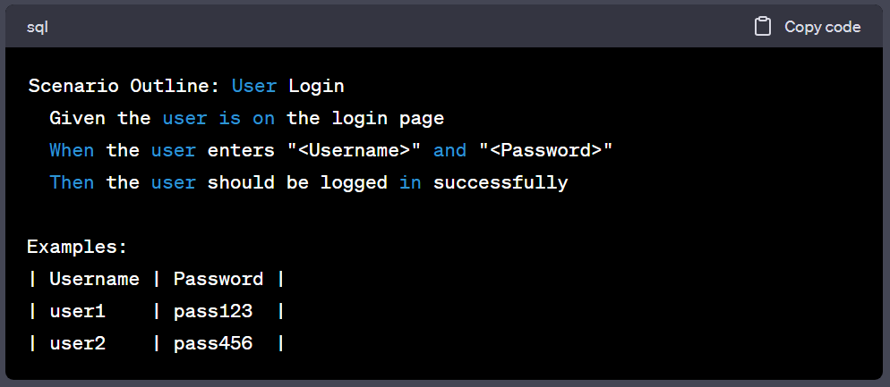
Writing Scenario Outlines:
To write a Scenario Outline, follow these steps:
| <UserEmail> | <Password> |
| email1@gmail.com | password@123 |
| email1@gmail.com | password@1234 |

Slide 6
Cucumber Background
In Cucumber, a Background is a way to define a set of common steps that are shared among multiple scenarios within a feature file. It allows you to eliminate repetitive steps and set up the preconditions for your scenarios in a more efficient manner.
What is a Background?
A Background is a block of steps that is executed before each scenario in a feature file. It is used to define the common preconditions or setup steps that are required for all scenarios within that feature. By using a Background, you can avoid duplicating the same steps in each scenario, making your feature file more concise and easier to maintain.
Anatomy of a Background:
A Background section in a feature file consists of the following elements:
Background keyword: It indicates the start of a Background block.
Background steps: These are the common steps that need to be executed before each scenario. These steps are shared among all scenarios within the feature file.

Slide 7
Writing Backgrounds:
To write a Background in a feature file, follow these steps:
1. Start with the Background keyword:
Background:
2. Write the common steps that need to be executed before each scenario:
Given <Precondition>
When <Action>
Then <Expected Outcome>
For example, let's consider a feature file for testing a login functionality with a common Background:

Slide 8
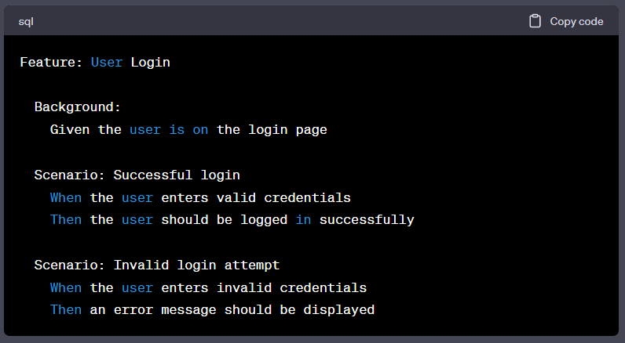
Writing Backgrounds:
In the above example, the Background section contains the common step "Given the user is on the login page". This step will be executed before each scenario in the feature file, ensuring that the user starts on the login page.

Slide 9
Sharing State Between Backgrounds and Scenarios:
A Background section can share state or context with the scenarios that follow it. This means that any data or variables set in the Background can be accessed by the scenarios. It allows you to set up common data or perform certain actions that are needed across scenarios.
For example, let's consider a feature file for testing a shopping cart functionality:

Slide 10
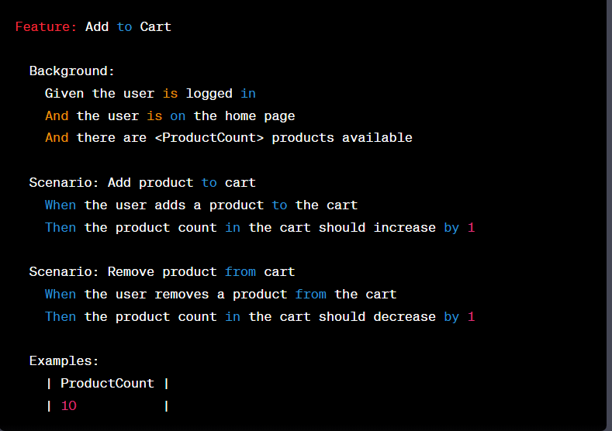
Sharing State Between Backgrounds and Scenarios:
In the example, the Background section sets up the common context for the scenarios by logging in, navigating to the home page, and specifying the available product count. This context is then shared with the scenarios, allowing them to perform actions based on that shared state.
By using Backgrounds in Cucumber, you can avoid repetition of common steps, improve the readability of your feature files, and establish a consistent setup for your scenarios. This makes your test scenarios more maintainable and efficient.

Slide 11
Summary of topics covered
Cucumber Scenario Outline allows executing scenarios with multiple data sets, enabling data-driven testing and reducing duplication.
It provides a concise and organized way to parameterize scenarios, making them versatile and adaptable.
Writing Scenario Outlines involves defining scenario templates with placeholders for input data and examples table for different data combinations.
Parameterizing Scenario Outlines allows running the same scenario with various inputs, making it efficient for testing different scenarios.
Cucumber Background helps eliminate repetitive steps by defining common preconditions or setup steps for each scenario.
Writing Backgrounds simplifies scenario creation by centralizing common steps, enhancing test readability and maintainability.
Cucumber Scenario Outline and Background are powerful features in Cucumber that promote reusability and maintainable test scenarios.
By using Scenario Outlines and Backgrounds effectively, testers can create concise, flexible, and efficient automated tests with Cucumber.

